Slide 1
Azure Cosmos DB Technical Deep Dive

Slide 2
Agenda
9:30-10:00 : Cosmos DB Introduction
10:30-11:00 : HOL Parts & Microsoft Learn Intro
11-11:15 : BREAK
11:15-12:30 : Databricks Delta
12:30-1:30 : LUNCH
1:30-3:30 : Delta -2

Slide 3
Azure Cosmos DB
A FULLY-MANAGED GLOBALLY DISTRIBUTED DATABASE SERVICE BUILT TO GUARANTEE
EXTREMELY LOW LATENCY AND MASSIVE SCALE FOR MODERN APPS

Slide 4


Azure Cosmos DB
A globally distributed, massively scalable, multi-model database service
Elastic scale out
of storage & throughput
Guaranteed low latency at the 99th percentile
Five well-defined consistency models
Turnkey global distribution
Comprehensive SLAs
Notes:
Azure Cosmos DB offers the first globally distributed, multi-model database service for building planet scale apps. It’s been powering Microsoft’s internet-scale services for years, and now it’s ready to launch yours.
Only Azure Cosmos DB makes global distribution turn-key.
You can add Azure locations to your database anywhere across the world, at any time, with a single click. Cosmos DB will seamlessly replicate your data and make it highly available.
Cosmos DB allows you to scale throughput and storage elastically, and globally! You only pay for the throughput and storage you need – anywhere in the world, at any time.

Slide 5
Azure Cosmos DB
A globally distributed, massively scalable, multi-model database service
Column-family
Document
Key-value
Graph
Elastic scale out
of storage & throughput
Guaranteed low latency at the 99th percentile
Five well-defined consistency models
Turnkey global distribution
Comprehensive SLAs
Notes:
Azure Cosmos DB offers the first globally distributed, multi-model database service for building planet scale apps. It’s been powering Microsoft’s internet-scale services for years, and now it’s ready to launch yours.
Only Azure Cosmos DB makes global distribution turn-key.
You can add Azure locations to your database anywhere across the world, at any time, with a single click. Cosmos DB will seamlessly replicate your data and make it highly available.
Cosmos DB allows you to scale throughput and storage elastically, and globally! You only pay for the throughput and storage you need – anywhere in the world, at any time.

Slide 6



Azure Cosmos DB
A globally distributed, massively scalable, multi-model database service
Cosmos DB’s API for
MongoDB
Table API
Column-family
Document
Key-value
Graph
Elastic scale out
of storage & throughput
Guaranteed low latency at the 99th percentile
Five well-defined consistency models
Turnkey global distribution
Comprehensive SLAs
Notes:
Azure Cosmos DB offers the first globally distributed, multi-model database service for building planet scale apps. It’s been powering Microsoft’s internet-scale services for years, and now it’s ready to launch yours.
Only Azure Cosmos DB makes global distribution turn-key.
You can add Azure locations to your database anywhere across the world, at any time, with a single click. Cosmos DB will seamlessly replicate your data and make it highly available.
Cosmos DB allows you to scale throughput and storage elastically, and globally! You only pay for the throughput and storage you need – anywhere in the world, at any time.

Slide 7

Overview & Value Proposition

Slide 8
Elastically Scale Storage and Throughput
Independently and elastically scale storage and throughput across regions – even during unpredictable traffic bursts – with a database that adapts to your app’s needs.
Elastically scale throughput from 10 to 100s of millions of requests/sec across multiple regions
Support for requests/sec for different workloads
Pay only for the throughput and storage you need
Notes:
Elastic Scale out -> Tunable Consistency
Small storage – large throughput (e.g. notification broadcast/poll)
Large storage – small throughput (e.g. classic data/log store)

Slide 9
Guaranteed Low Latency
Provide users around the world with fast access to data
Serve <10 ms read and <10 ms write requests at the 99th percentile from the region nearest to users, while delivering data globally.
Notes:
Single digit latency -> SLA

Slide 10
Turnkey Global Distribution
Put your data where your users are in minutes
Automatically replicate all your data around the world, and across more regions than Amazon and Google combined.
Available in all Azure regions
Manual and automatic failover
Automatic & synchronous multi-region replication
Configure multiple write regions to further reduce latency and increase availability
Notes:
Elastic Scale out -> Tunable Consistency
Small storage – large throughput (e.g. notification broadcast/poll)
Large storage – small throughput (e.g. classic data/log store)

Slide 11
Five Well-Defined Consistency Models
Choose the best consistency model for your app
Offers five consistency models
Provides control over performance-consistency tradeoffs, backed by comprehensive SLAs.
An intuitive programming model offering low latency and high availability for your planet-scale app.
Strong
Bounded-stateless
Session
Consistent prefix
Eventual
Notes:
Tunable Consistency -> Single digit latency
Instead of forcing you to choose between eventual and strong consistency, Cosmos DB gives you many additional useful options.
Bounded Staleness - Consistent Prefix. Reads lag behind writes by k prefixes or t interval
Session - Consistent Prefix. Monotonic reads, monotonic writes, read-your-writes, write-follows-reads
Consistent Prefix - Updates returned are some prefix of all the updates, with no gaps

Slide 12


Multiple Data Models and API’s
Use the model that fits your requirements, and the apis, tools, and frameworks you prefer
Cosmos DB offers a multitude of APIs to access and query data including, SQL, various popular OSS APIs, and native support for NoSQL workloads.
Use key-value, columnar, graph, and document data
Data is automatically indexed, with no schema or secondary indexes required
Blazing fast queries with no lag
MongoDB
Table API
SQL
Column-family
Document
Key-value
Graph
Notes:
Multi – Model -> Elastic Scale out
No need to convert you data to meet any particular model

Slide 13
Handle any Data with no Schema or Indexing Required
Azure Cosmos DB’s schema-less service automatically indexes all your data, regardless of the data model, to delivery blazing fast queries.
Automatic index management
Synchronous auto-indexing
Freedom from schema + index management
Works across every data model
Ingest and serve data back out in milliseconds
GEEK
Item | Color | Microwave safe | Liquid capacity | CPU | Memory | Storage
Geek mug | Graphite | Yes | 16ox | ??? | ??? | ???
Coffee Bean mug | Tan | No | 12oz | ??? | ??? | ???
Surface book | Gray | ??? | ??? | 3.4 GHz Intel Skylake Core i7-6600U | 16GB | 1 TB SSD
Notes:
Automatic and synchronous indexing of all ingested content - hash, range, geo-spatial, and columnar
No schemas or secondary indices ever needed
Resource governed, write optimized database engine with latch free and log structured techniques
Online and in-situ index transformations
While the database is fully schema-agnostic, schema-extraction is built in
Customers can get Avro schemas from the database

Slide 14
Comprehensive SLA’s
Run your app on world-class infrastructure.
Azure Cosmos DB is the only service with financially-backed SLAs for millisecond latency at the 99th percentile, 99.999% HA and guaranteed throughput and consistency
Latency
HA
Throughput
Consistency
<10 ms
99.999%
Guaranteed
Guaranteed
99th percentile
Notes:
HA 99.999% for multi-region read; 99.99% for single region deployments

Slide 15
Trust your Data to Industry-Leading Security & Compliance
Azure is the world’s most trusted cloud, with more certifications than any other cloud provider.
Enterprise grade security
Encryption at Rest and Transit
Encryption is enabled automatically by default
Comprehensive Azure compliance certification
Notes:
Encryption at Rest
Always encrypted at rest and in motion
Data, index, backups, and attachments encrypted
Encryption is enabled automatically by default
No impact on performance, throughput or availability
Transparent to your application
Comprehensive Azure compliance certification
ISO 27001, ISO 27018, EUMC, HIPAA, PCI
SOC1 and SOC2 (Audit complete, Certification in Q2 2017)
FedRAMP, IRS 1075, UK Official (IL2) (Q2 2017)
HITRUST (H2 2017)
Updated and added to monthly

Slide 16
Resource Model

Slide 17
Resource Model
Account
Database
Database
Database
Database
Database
Container
Database
Database
Item
Notes:
A tenant of the Cosmos DB service starts by provisioning a database account. A database account manages one or more databases. A Cosmos DB database manages users, permissions and containers. A Cosmos DB resource container is a schema-agnostic container of arbitrary user-generated JSON items and JavaScript based stored procedures, triggers and user-defined-functions (UDFs). Entities under the tenant’s database account – databases, users, permissions, containers etc. are referred to as resources.
Each resource is uniquely identified by a stable and logical URI and represented as a JSON document. The overall resource model of an application using Cosmos DB is a hierarchical overlay of the resources rooted under the database account, and can be navigated using hyperlinks. Except for the item resource, which is used to represent arbitrary user defined JSON content, all other resources have a system-defined schema.
Container and item resources are further projected as reified resource types for a specific type of API interface. For example, while using document-oriented APIs, container and item resources are projected as collection (container) and document (item) resources, respectively; likewise, for graph-oriented API access, the underlying container and item resources are projected as graph (container), node (item) and edge (item) resources respectively; while accessing using a key-value API table (container) and item/row (item) are projected.

Slide 18
Account URI and Credentials
Account
********.azure.com
Database
Database
Database
IGeAvVUp …
Database
Database
Container
Database
Database
Item

Slide 19
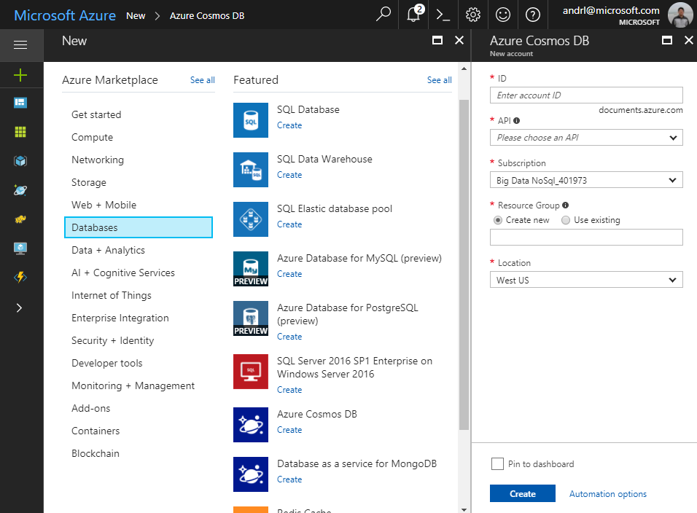
Creating Account
Account
Database
Database
Database
Database
Database
Container
Database
Database
Item

Slide 20
Database Representations
Account
Database has 1 or more containers
Database
Database
Database
Database
Database
Container
Database
Database
Item

Slide 21
Container Representations
Account
Container – can be a collection, graph or table
Database
Database
Database
Database
=
Database
Container
Collection
Graph
Table
Database
Database
Item

Slide 22
Creating Collections – SQL API
Account
Items – can be document, vertices/edges, or row
Database
Database
Database
Database
Database
Container
Collection
Graph
Table
Database
Database
Item
Document Vertices/Edges Row

Slide 23
Container-Level Resources
Account
Associate stored procedures, triggers, UDF with container
Database
Database
Database
Database
Database
Container
Database
Database
Sproc
Trigger
UDF
Item

Slide 24
Request Units & Billing

Slide 25
Billing Model
2 components: Storage + Throughput
You are billed on consumed storage and provisioned throughput
Collections in a database can share throughput
Unit | Price (for most Azure regions)
SSD Storage (per GB) | $0.25 per month
Provisioned Throughput (single region writes) | $0.008/hour per 100 RU/s
Provisioned Throughput (multi-region writes) | $0.016/hour per 100 multi-master RU/s
* pricing may vary by region; for up-to-date pricing, see: https://azure.microsoft.com/pricing/details/cosmos-db/

Slide 26
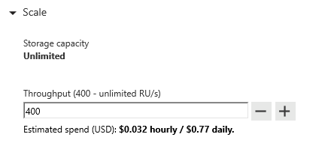
Request Units
Request Units (RUs) is a rate-based currency – e.g. 1000 RU/second
Abstracts physical resources for performing requests
% Memory
% CPU
% IOPS

Slide 27
Request Units
Each request consumes # of RU
Approx. 1 RU = 1 read of 1 KB document
Approx. 5 RU = 1 write of a 1KB document
Query: Depends on query & documents involved
GET
=
POST
=
PUT
=
Query
=
…
Notes:
The number of RU’s each operation consumes depends on many factors which include:
Document size
Number of indexed fields
Type of indexes
Consistency model choice
Not all queries will consume equal numbers of RU’s. Some operations are more computationally complex or require scans through more documents and therefore use more RU’s.

Slide 28
Request Units- Provisioned throughput
Provisioned in terms of RU/sec – e.g. 1000 RU/s
Billed for highest RU/s in 1 hour
Easy to increase and decrease on demand
Rate limiting based on amount of throughput provisioned
Background processes like TTL expiration, index transformations scheduled when quiescent
Storage: 40RU per 1GB of data
Rate limiting – SDK retry
Max RU/sec
Incoming Requests
No rate limiting
Min RU/sec
No rate limiting, process background operations
Notes:
We want to avoid throttling (rate limiting)

Slide 29
Estimating required RU/s
Operation Type | # Requests per sec | # RU's per Request | RU's Needed
Write Single Document | 10,000 | 10 | 100,000
Top Query #1 | 700 | 100 | 70,000
Top Query #2 | 200 | 100 | 20,000
Top Query #3 | 100 | 100 | 10,000
Total RU/s |  |  | 200,000 RU/s
Guidance:
Identify query & access patterns – e.g. top 5 queries, or # reads/writes per second
Use ‘Request Charge’ property from SDK + sample document to see # RU / operation
POC / Load test -> Scale up, and scale down
Scale 5-10x above the average number of RU’s needed per second

Slide 30
Database Level Throughput
You can provision throughput at the database level instead of individually for each container
Throughput is shared among each designated container within the database
You can provision dedicated throughput for some containers
Notes:
We want to avoid throttling (rate limiting)

Slide 31
Database vs Container Level Throughput
In general, container level throughput is a good choice. This leads to predictable performance since each container is guaranteed its provisioned RU’s
Choosing Database Level Throughput can also be a good option if:
You are migrating many containers in a lift and shift migration (from Table Storage, MongoDB, or Cassandra) and does not know how much throughput to set for each one
You have containers that are timeshared
Multitenant applications where each user is represented by a separate container
Notes:
We want to avoid throttling (rate limiting)

Slide 32
Pricing Example – Do this exercise to ballpark cost + RU/s required
Storage Cost
Avg Record Size (KB) | 1
Number of Records | 100,000,000
Total Storage (GB) | 100
Monthly Cost per GB | $0.25
Expected Monthly Cost for Storage | $25.00
Throughput Cost
Operation Type | Number of Requests per sec | Avg RU's per Request | RU's Needed
Create | 100 | 5 | 500
Read | 400 | 1 | 400
Total RU/sec | 900
Hourly Cost per 100 RU/sec | $0.008
Monthly Cost per 100 RU/sec | $6.00
Expected Monthly Cost for Throughput | $54.00
Total Monthly Cost
[Total Monthly Cost] = [Monthly Cost for Storage] + [Monthly Cost for Throughput]
= $25 + $54
= $79 per month
* pricing may vary by region; for up-to-date pricing, see: https://azure.microsoft.com/pricing/details/cosmos-db/

Slide 33
Cosmos DB reserved Capacity can provide up to 65% savings
Save up to 65% with Azure Cosmos DB reserved capacity pricing
+ Up to 65% savings
Customer cost
Best value for the price
Best elasticity for the price
Saturation of provisioned capacity via sub-core multiplexing
Deep integration w/ Azure Networking
No need to segment
into read and write workloads –
w/ unified and normalized throughput currency - RUs
Total Time To Live (TTL) is free
Enterprise-ready (security, compliance, encryption) at no additional cost

Slide 34
Azure Cosmos DB Reserved Capacity
Marginal Discounts
 | 1 Year |  | 3 Year
Throughput | Single Region Writes | Multiple Regions Writes | Single Region Writes | Multiple Regions Writes
First 100K RU/s | 20% | 25% | 30% | 35%
Next 400K RU/s | 25% | 30% | 35% | 40%
Next 2.5M RU/s | 30% | 35% | 45% | 50%
Over 3M RU/s | 45% | 50% | 60% | 65%
Azure Cosmos DB Reserved Capacity helps you save money by pre-paying for one-year or three-years of Cosmos DB capacity allowing you to get a discount on the Cosmos DB resources, e.g., databases, containers (tables/collections/graphs) you use.
Azure Cosmos DB Reserved Capacity can significantly reduce your Cosmos DB costs—up to 65 percent on regular prices–with one-year or three-year upfront commitment.
Reserved Capacity provides a billing discount and does not affect the runtime state of your Cosmos DB resources.
Effective Discounts
Amount | 1 Year – single region writes | 3 Year - single region writes | 1 Year - multiple region writes | 3 Year - multiple region writes
100,000 | 20.00% | 30.00% | 25.00% | 35.00%
500,000 | 24.00% | 34.00% | 29.00% | 39.00%
1,000,000 | 27.00% | 39.50% | 32.00% | 44.50%
2,000,000 | 28.50% | 42.25% | 33.50% | 47.25%
3,000,000 | 29.00% | 43.17% | 34.00% | 48.17%
5,000,000 | 35.40% | 49.90% | 40.40% | 54.90%
10,000,000 | 40.20% | 54.95% | 45.20% | 59.95%
20,000,000 | 42.60% | 57.48% | 47.60% | 62.48%
30,000,000 | 43.40% | 58.32% | 48.40% | 63.32%

Slide 35
Data Modeling

Slide 36
Data Modeling
Is just as important with relational data!
There’s still a schema – just enforced at the application level
Plan upfront for best performance & costs
Feedback: “Small collections add up ->$$$”
Answer: Smart data modelling will help

Slide 37




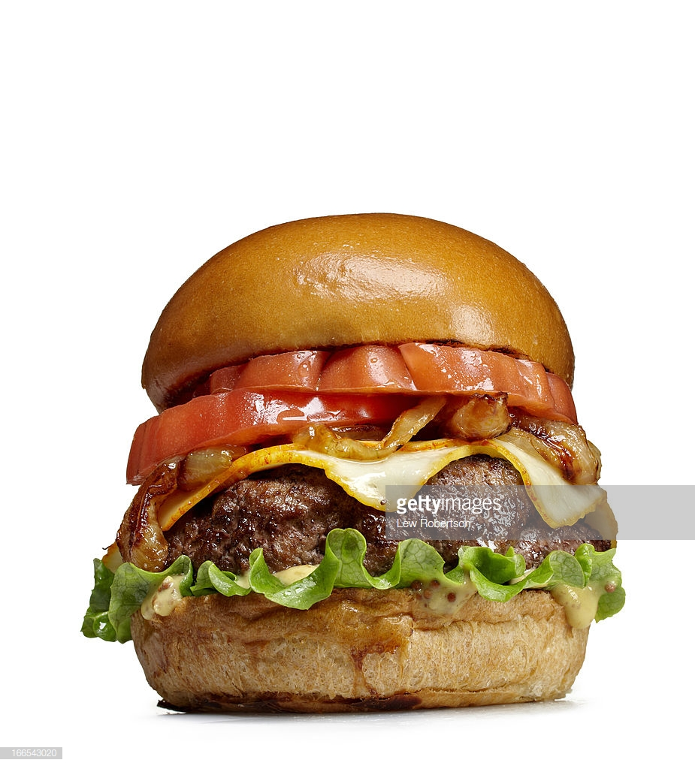
2 Extremes
ORM
SQL
Normalize everything
NoSQL
Embed as 1 piece

Slide 38
Contoso Restaurant Menu
Menu Item
------------
ID
Item Name
Item Description
Item Category ID
Category
------------
ID
Category Name
Category Description
Relational modelling – Each menu item has a reference to a category.
{
"ID": 1,
"ItemName": "hamburger",
"ItemDescription": "cheeseburger, no cheese",
“CategoryId": 5,
"Category": "sandwiches"
"CategoryDescription": "2 pieces of bread + filling"
}
Non-relational modeling – each menu item is a self-contained document

Slide 39




Number 1 question…
“Where are my joins?”
“Where are my joins!?!?”
Naïve way: Normalize, make 2 network calls, merge client side
But! We can model our data in a way to get the same functionality of a join, without the tradeoff

Slide 40
Modeling Challenges
#1: To de-normalize, or normalize? To embed, or to reference?
#2: Put data types in same collection, or different?

Slide 41
Modeling challenge #1: To embed or reference?
Embed
{
"menuID": 1,
"menuName": "Lunch menu",
"items": [
{"ID": 1, "ItemName": "hamburger", "ItemDescription":...}
{"ID": 2, "ItemName": "cheeseburger", "ItemDescription":...}
]
}
Reference
{
"menuID": 1,
"menuName": "Lunch menu",
"items": [
{"ID": 1}
{"ID": 2}
]
}
{"ID": 1, "ItemName": “hamburger", "ItemDescription":...}
{"ID": 2, "ItemName": “cheeseburger", "ItemDescription":...}

Slide 42
When To Embed #1
{
"ID": 1,
"ItemName": "hamburger",
"ItemDescription": "cheeseburger, no cheese",
"Category": "sandwiches",
"CategoryDescription": "2 pieces of bread + filling",
"Ingredients": [
{"ItemName": "bread", "calorieCount": 100, "Qty": "2 slices"},
{"ItemName": "lettuce", "calorieCount": 10, "Qty": "1 slice"}
{"ItemName": "tomato","calorieCount": 10, "Qty": "1 slice"}
{"ItemName": "patty", "calorieCount": 700, "Qty": "1"}
}
E.g. in Recipe, ingredients are always queried with the item

Slide 43
When To Embed #2
Child data is dependent/intrinsic to a parent
{
"id": "Order1",
"customer": "Customer1",
"orderDate": "2018-09-26",
"itemsOrdered": [
{"ID": 1, "ItemName": "hamburger", "Price":9.50, "Qty": 1}
{"ID": 2, "ItemName": "cheeseburger", "Price":9.50, "Qty": 499}
]
}
Items Ordered depends on Order

Slide 44
When To Embed #3
1:1 relationship
{
"id": "1",
"name": "Alice",
"email": "alice@contoso.com",
“phone": “555-5555"
“loyaltyNumber": 13838359,
"addresses": [
{"street": "1 Contoso Way", "city": "Seattle"},
{"street": "15 Fabrikam Lane", "city": "Orlando"}
]
}
All customers have email, phone, loyalty number for 1:1 relationship

Slide 45
When To Embed #4, #5
Similar rate of updates – does the data change at the same (slower) pace? -> Minimize writes
1:few relationships
{
"id": "1",
"name": "Alice",
"email": "alice@contoso.com",
"addresses": [
{"street": "1 Contoso Way", "city": "Seattle"},
{"street": "15 Fabrikam Lane", "city": "Orlando"}
]
}
//Email, addresses don’t change too often

Slide 46
When To Embed - Summary
Data from entities is queried together
Child data is dependent on a parent
1:1 relationship
Similar rate of updates – does the data change at the same pace
1:few – the set of values is bounded
Usually embedding provides better read performance
Follow-above to minimize trade-off for write perf

Slide 47
Approach- Introduce Type Property
Ability to query across multiple entity types with a single network request.
For example, we have two types of documents: person and cat
{
"id": "Ralph",
"type": "Cat",
"familyId": "Liu",
"fur": {
"length": "short",
"color": "brown"
}
}
{
"id": "Andrew",
"type": "Person",
"familyId": "Liu",
"worksOn": "Azure Cosmos DB"
}

Slide 48
Approach- Introduce Type Property
Ability to query across multiple entity types with a single network request.
For example, we have two types of documents: person and cat
{
"id": "Ralph",
"type": “Cat",
"familyId": "Liu",
"fur": {
"length": "short",
"color": "brown"
}
}
{
"id": "Andrew",
"type": "Person",
"familyId": "Liu",
"worksOn": "Azure Cosmos DB"
}
We can query both types of documents without needing a JOIN simply by running a query without a filter on type:
SELECT * FROM c WHERE c.familyId = "Liu"

Slide 49
Handle any data with no schema or indexing required
Azure Cosmos DB’s schema-less service automatically indexes all your data, regardless of the data model, to delivery blazing fast queries.
Automatic index management
Synchronous auto-indexing
No schemas or secondary indices needed
Works across every data model
GEEK
Item | Color | Microwave safe | Liquid capacity | CPU | Memory | Storage
Geek mug | Graphite | Yes | 16ox | ??? | ??? | ???
Coffee Bean mug | Tan | No | 12oz | ??? | ??? | ???
Surface book | Gray | ??? | ??? | 3.4 GHz Intel Skylake Core i7-6600U | 16GB | 1 TB SSD
Notes:
At global scale, schema/index management is hard
Automatic and synchronous indexing of all ingested content – range and geo-spatial
No need to define schemas or secondary indices upfront
Resource governed, write optimized database engine with latch free and log structured techniques
Online and in-situ index transformations

Slide 50
Indexing JSON Documents
{
"locations": [
{
"country": "Germany",
"city": "Berlin"
},
{
"country": "France",
"city": "Paris"
}
],
"headquarter": "Belgium",
"exports": [
{ "city": "Moscow" },
{ "city": "Athens" }
]
}
locations
headquarter
exports
0
1
Belgium
0
1
country
city
country
city
city
city
Germany
Berlin
France
Paris
Moscow
Athens

Slide 51
Indexing JSON Documents
{
"locations": [
{
"country": "Germany",
"city": "Bonn",
"revenue": 200
}
],
"headquarter": "Italy",
"exports": [
{
"city": "Berlin",
"dealers": [
{ "name": "Hans" }
]
},
{ "city": "Athens" }
]
}
locations
headquarter
exports
0
Italy
0
1
country
city
revenue
city
dealers
city
Germany
Bonn
200
Berlin
0
name
Hans

Slide 52
Indexing JSON Documents
locations
headquarter
exports
locations
headquarter
exports
+
0
1
Belgium
0
1
0
Italy
0
1
country
city
country
city
city
city
country
city
revenue
city
dealers
city
Germany
Berlin
France
Paris
Moscow
Athens
Germany
Bonn
200
Berlin
0
Athens
name
Hans
Notes:
{
"locations": [
{
"country": "Germany",
"city": "Berlin"
},
{
"country": "France",
"city": "Paris"
}
],
"headquarter": "Belgium",
"exports": [
{ "city": "Moscow" },
{ "city": "Athens" }
]
}
{
"locations": [
{
"country": "Germany",
"city": "Bonn",
"revenue": 200
}
],
"headquarter": "Italy",
"exports": [
{
"city": "Berlin",
"dealers": [
{ "name": "Hans" }
]
},
{ "city": "Athens" }
]
}

Slide 53
Inverted Index
{1, 2}
{1, 2}
locations
{1, 2}
headquarter
{1, 2}
exports
{1, 2}
0
{1}
1
{1}
Belgium
{2}
Italy
{1, 2}
0
{1, 2}
1
{1, 2}
country
{1, 2}
city
{1, 2}
revenue
{1, 2}
country
{1, 2}
city
{1, 2}
city
{2}
dealers
{1, 2}
city
{1}
Berlin
{1}
France
{1}
Paris
{1}
Moscow
{1, 2}
Germany
{2}
Bonn
{2}
200
{2}
Berlin
{2}
0
{2}
Athens
{2}
name
{2}
Hans

Slide 54
Partitioning

Slide 55
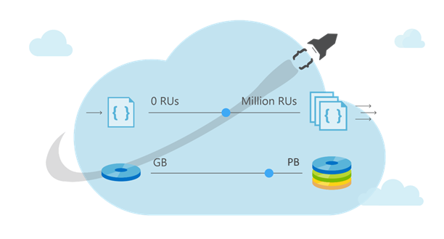
Partitioning
Leveraging Azure Cosmos DB to automatically scale your data across the globe
This module will reference partitioning in the context of all Azure Cosmos DB modules and APIs.

Slide 56
Partitioning- Why Do We Do It In The First Place?
As data size grows, instead of buying more machines (scaling up) we distribute our data across multiple machines
Each machine is responsible for serving subset of the data.
Analogy: Working in a team

Slide 57
Partitioning
Logical partition: Stores all data associated with the same partition key value
Physical partition: Fixed amount of reserved SSD-backed storage + compute.
Cosmos DB distributes logical partitions among a smaller number of physical partitions.
From user’s perspective: define 1 partition key per container

Slide 58
Partitions
Partitions
hash(City ID)
….
Beijing
Redmond
Seattle
Shanghai
Paris
Partition 1
Partition 2
Partition N
Range 1
Range 2
Range X

Slide 59
Partitions
Documents with same partition key value (City ID) are in same partition
hash(City ID)
Beijing
Shanghai
….
Beijing
Redmond
Seattle
Shanghai
Paris
Partition 1
Partition 2
Partition N
Range 1
Range 2
Range X

Slide 60
Partitions
hash(City ID)
Automatically split when close to full
….
Tianjin
Austin
…
Berlin
…
Beijing
Redmond
Tianjin
+
Seattle
Shanghai
Austin
Paris
Partition x2
Berlin
Partition x1
Partition 1
Partition 2
Partition N
Range X1
Range X2
Range 1
Range 2
Range X

Slide 61
RU’s divided among Partitions
10,000 RU/s provisioned for collection
Cosmos DB distributes RU/s evenly across physical partitions
hash(City ID)
2000 RU/s
2000 RU/s
2000 RU/s
….
Beijing
Redmond
Tianjin
Seattle
Shanghai
Austin
Paris
Berlin
Partition 1
Partition 2
Partition 5
Range 1
Range 2
Range 5

Slide 62
Hot/Cold Partitions
Partition Usage Can Vary Over Time
Partitions that are approaching thresholds are referred to as hot. Partitions that are underutilized are referred to as cold.
Abstract Storage or Throughput Threshold
Hot Partition
Partition
Partition
Cold Partition
Cold Partition

Slide 63
Cross-Partition Query

Slide 64

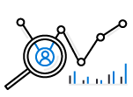



Partition Design
EXAMPLE SCENARIO
Contoso Connected Car is a vehicle telematics company. They are planning to store vehicle telemetry data from millions of vehicles every second in Azure Cosmos DB to power predictive maintenance, fleet management, and driver risk analysis.
WHAT ARE A FEW POTENTIAL PARTITION KEY CHOICES?
Vehicle Model
Current Time
Device Id
Composite Key – Device ID + Current Time
Example – Contoso Connected Car
Notes:
Design Goals for Choosing a Good Partition Key
Distribute the overall request + storage volume
Avoid “hot” partition keys
Partition Key is scope for [efficient] queries and transactions
Queries can be intelligently routed via partition key
Omitting partition key on query requires fan-out
Steps for Success
Ballpark scale needs (size/throughput)
Understand the workload
# of reads/sec vs writes per sec
Use 80/20 rule to help optimize bulk of workload
For reads – understand top X queries (look for common filters)
For writes – understand transactional needs understand ratio of inserts vs updates
General Tips
Don’t be afraid of having too many partition keys
Partitions keys are logical
More partition keys => more scalability

Slide 65
Partition Key Choices
VEHICLE MODEL (e.g. Model A)
Most auto manufactures only have a couple dozen models. This will create a fixed number of logical partition key values; and is potentially the least granular option.
Depending how uniform sales are across various models – this introduces possibilities for hot partition keys on both storage and throughput.
CURRENT MONTH (e.g. 2018-04)
Auto manufacturers have transactions occurring throughout the year. This will create a more balanced distribution of storage across partition key values.
However, most business transactions occur on recent data creating the possibility of a hot partition key for the current month on throughput.
Storage Distribution
Throughput Distribution
Storage Distribution
Throughput Distribution
Rodel
Rodel
2018-03
2018-03
Prisma
Prisma
2018-04
2018-04
Turlic
Turlic
2018-05
2018-05
Coash
Coash
2018-06
2018-06
Example – Contoso Connected Car

Slide 66
Partition Key Choices
DEVICE ID (e.g. Device123)
Each car would have a unique device ID. This creates a large number of partition key values and would have a significant amount of granularity.
Depending on how many transactions occur per vehicle, it is possible to a specific partition key that reaches the storage limit per partition key
COMPOSITE KEY (Device ID + Time)
This composite option increases the granularity of partition key values by combining the current month and a device ID. Specific partition key values have less of a risk of hitting storage limitations as they only relate to a single month of data for a specific vehicle.
Throughput in this example would be distributed more to logical partition key values for the current month.
Storage Distribution
Throughput Distribution
Storage Distribution
Throughput Distribution
C49E27EB
C49E27EB
C49E27EB-2018-05
C49E27EB-2018-05
FE53547A
FE53547A
C49E27EB-2018-06
C49E27EB-2018-06
E84906BE
E84906BE
4376B4BC-2018-05
4376B4BC-2018-05
4376B4BC
4376B4BC
4376B4BC-2018-06
4376B4BC-2018-06
Example – Contoso Connected Car
Notes:
Device ID is likely a good choice for this data. Obviously we did not take into account the workload’s queries so this could impact the choice as well. For example, if the workload had a lot of filters based on Vehicle Model, this could make it a better choice.

Slide 67

Change Feed

Slide 68
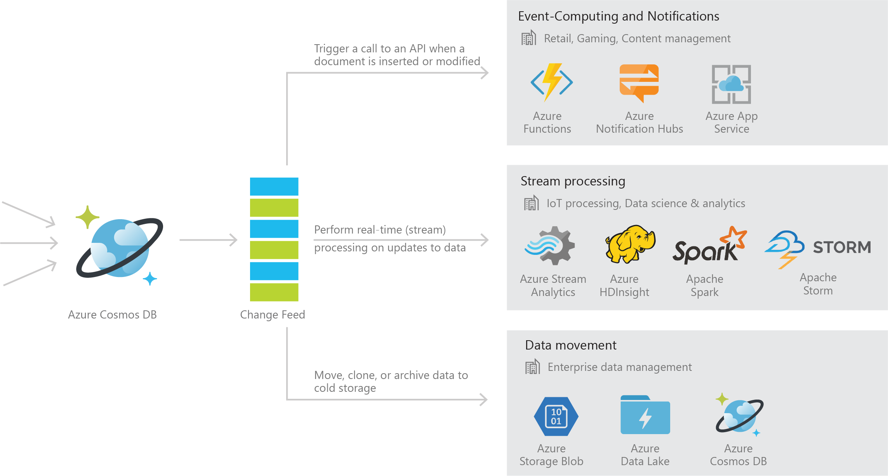
Azure Cosmos DB Change Feed
Persistent log of records within an Azure Cosmos DB container in the order in which they were modified

Slide 69
Common Scenarios

Slide 70

Common Use Cases and Scenarios

Slide 71






Internet of Things – Telemetry & Sensor Data
Business Needs:
High scalability to ingest large # of events coming from many devices
Low latency queries and changes feeds for responding quickly to anomalies
Schema-agnostic storage and automatic indexing to support dynamic data coming from many different generations of devices
High availability across multiple data centers

Slide 72









Internet of Things – Telemetry & Sensor Data
Aggregated + Archived Events (Cold)
pre-aggregates
Apache Storm on
Azure HDInsight
Azure Cosmos DB (Hot)
(telemetry and device state)
Azure IoT Hub
high-fidelity events
latest state
PowerBI
Azure Function
Azure Web Jobs
(Change feed processor)

Slide 73





Retail – Product Catalog & Order Processing
Business Needs:
Elastic scale to handle seasonal traffic (e.g. Black Friday)
Low-latency access across multiple geographies to support a global user-base and latency sensitive workloads (e.g. real-time personalization)
Schema-agnostic storage and automatic indexing to handle diverse product catalogs, orders, and events
High availability across multiple data centers

Slide 74



Retail Product Catalogs
Azure Web App
(e-commerce app)
Azure Cosmos DB
(product catalog)
Azure Search (full-text index)
Azure Storage
(logs, static catalog content)
Azure Cosmos DB
(session state)

Slide 75



Retail Order Processing Pipelines
Azure Functions
(E-Commerce Checkout API)
Azure Cosmos DB (Order Event Store)
. . .
Azure Functions
(Microservice 1: Tax)
Azure Functions
(Microservice 2: Payment)
Azure Functions
(Microservice N: Fufillment)

Slide 77




Multiplayer Gaming
Business Needs:
Elastic scale to handle bursty traffic on day
Low-latency queries to support responsive gameplay for a global user-base
Schema-agnostic storage and indexing allows teams to iterate quickly to fit a demanding ship schedule
Change-feeds to support leaderboards and social gameplay

Slide 78




Multiplayer Gaming
Azure CDN
Azure Storage
(game files)
Azure API Apps
(game backend)
Azure Cosmos DB
(game database)
Azure HDInsight (game analytics)
Azure Traffic Manager
Azure Functions
Azure Notification Hubs
(push notifications)

Slide 79
Change Feed

Slide 80
Azure Cosmos DB Change Feed
Persistent log of records within an Azure Cosmos DB container in the order in which they were modified

Slide 81
Common Scenarios

Slide 82

Event Sourcing for Microservices
Trigger Action From Change Feed
Persistent Event Store
Microservice
#1
Microservice #2
New Event
…
Microservice #N

Slide 83
Materializing Views
Application
Cosmos DB
Materialized View
Subscription | User | Create Date | …
123abc | Ben6 | 6/17/17
456efg | Ben6 | 3/14/17
789hij | Jen4 | 8/1/16
012klm | Joe3 | 3/4/17
User | Total Subscriptions
Ben6 | 2
Jen4 | 1
Joe3 | 1

Slide 84


Replicating Data
Secondary Datastore (e.g. archive)
Replicate Records
CRUD Data

Slide 85
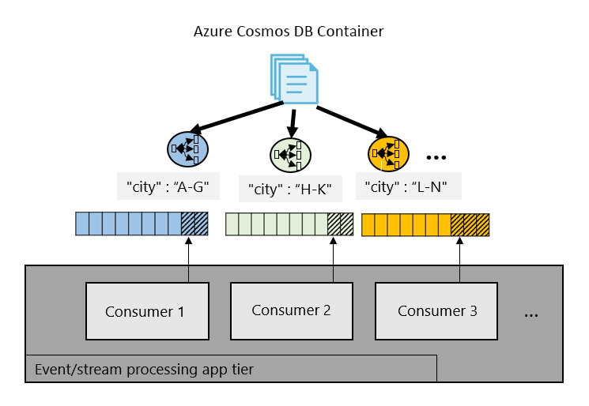
Working with Change Feed

Slide 86
Thank you and Q&A

